Slide 1

Fashion on a budget
Anisah Alahmed

Slide 2
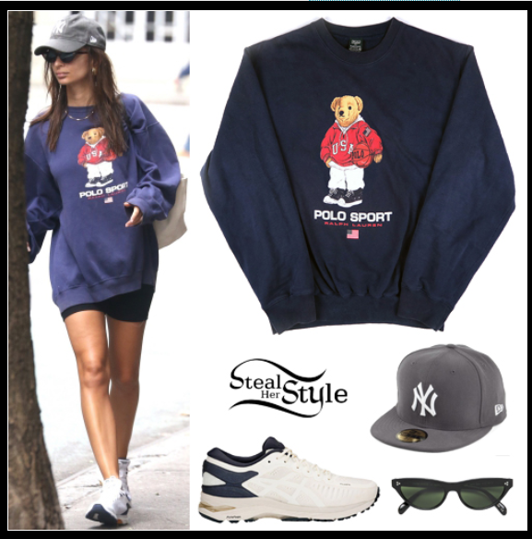
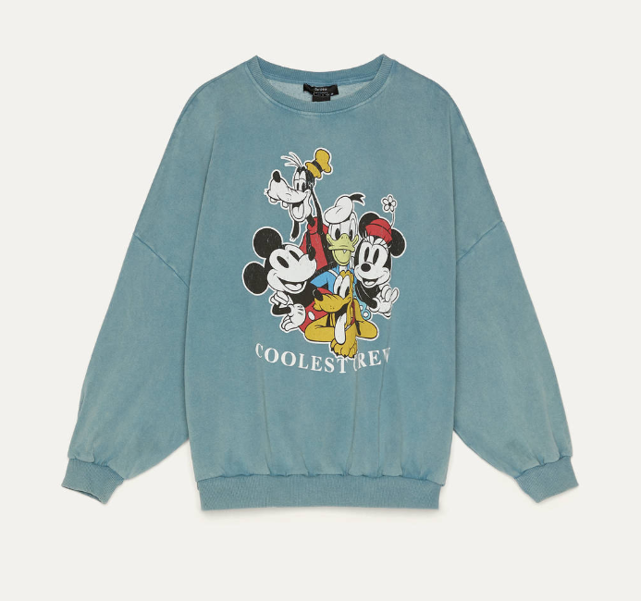
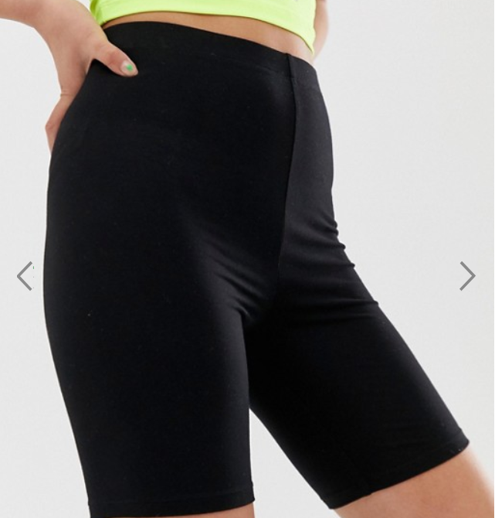
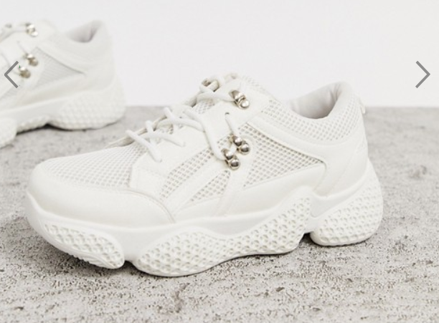
Casual look ~$400 vs $96.9
$39.90 Bershka
$8.00
COLLUSION
$49.00
Public Desire
$150 Ralph Lauren sweatshirt
$250 Asics Metarun sneakers
Shorts (not listed)

Slide 3
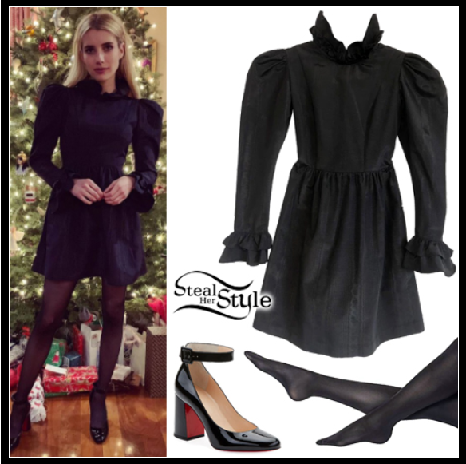
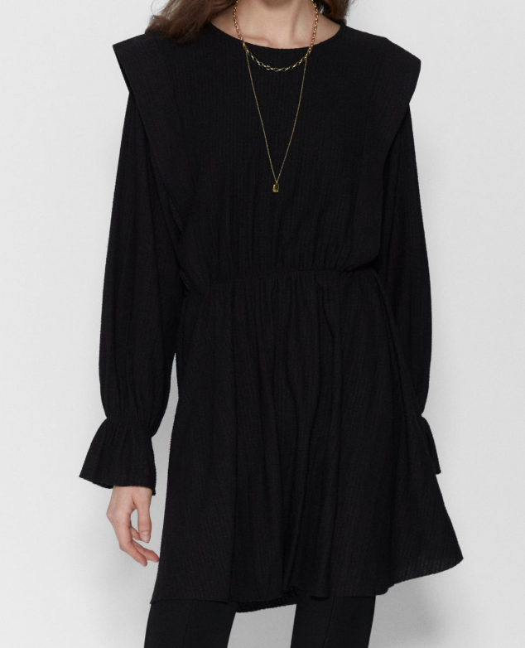
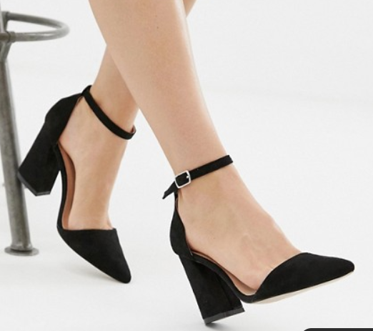
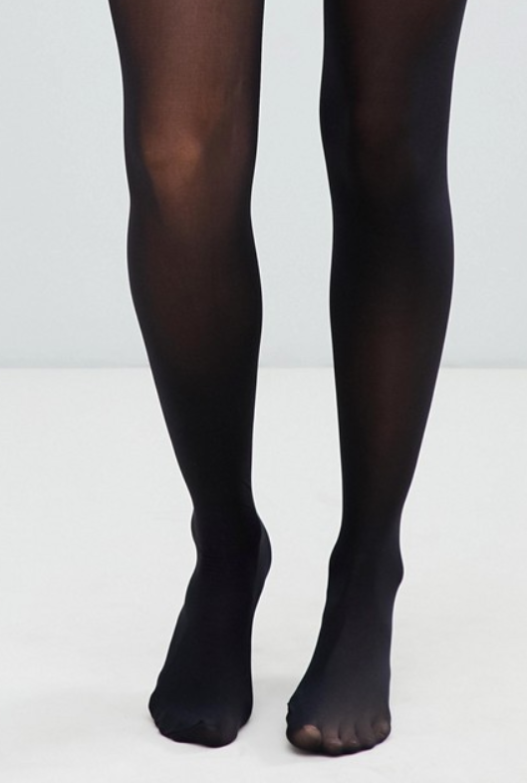
Business casual look $1191.45 vs $86.9
$38.00
Glamorous
$480 Batsheva mini Prairie dress
$42 Woldford pure 50 tights
$669.45 Christian Louboutin soval patent leather mary jane pumps
$35.90
ZARA
$13.00
ASOS

Slide 4
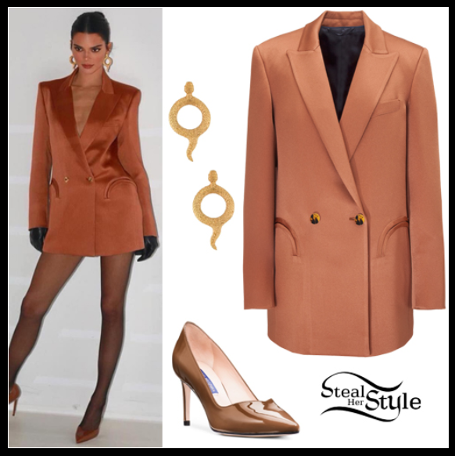
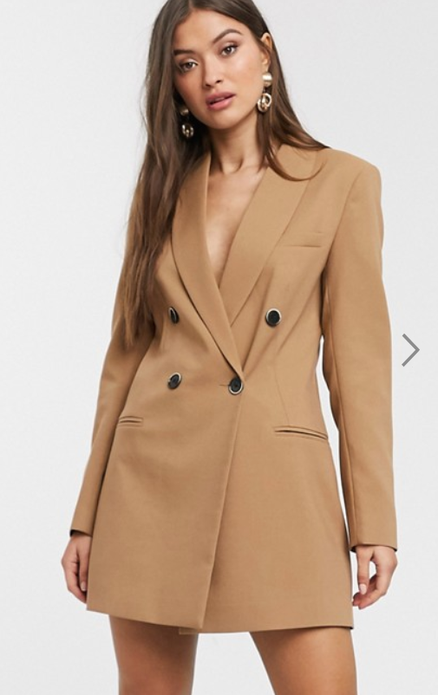
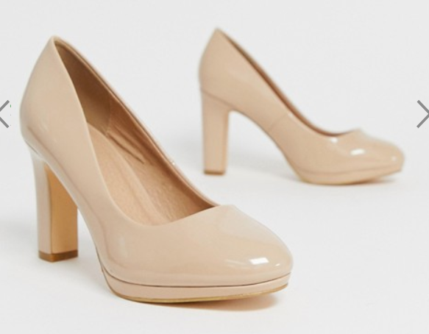
Professional look $1404.36 vs $95.00
$35.00
Simply be
$1006.36Blaze Milano everyday double-breasted blazer
$398.00 Stuart Weitzman anny pumps
$60.00
Stradivarius

